Slide 1
Introduction to Computer Science
Artificial Intelligence

Slide 2
Objectives
In this chapter, you will learn about
Basic AI concepts
AI applications
Related topics in AI
A brief history of AI

Slide 3
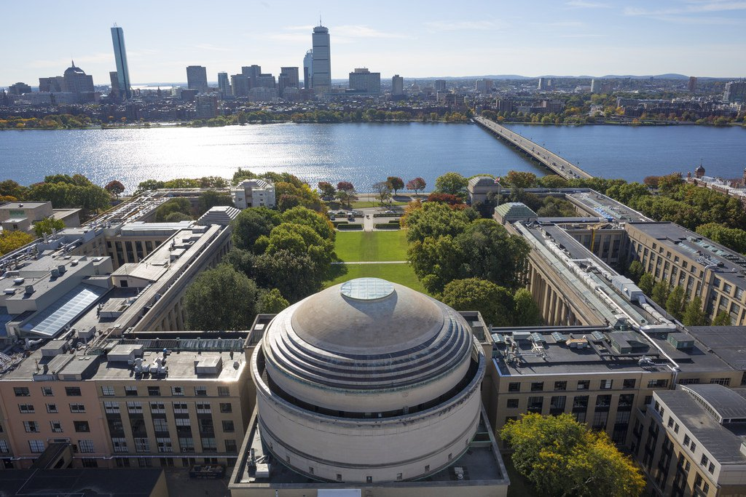
MIT has just announced a $1 billion plan to create a new college for AI (15/10)
https://www.technologyreview.com/the-download/612293/mit-has-just-announced-a-1-billion-plan-to-create-a-new-college-for-ai/?utm_medium=social&utm_source=facebook.com&utm_campaign=owned_social

Slide 4
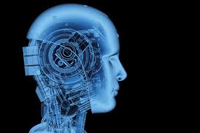
Artificial Intelligence
Artificial intelligence (AI) – computer based systems that emulate human intelligence such as the ability to reason and learn
AI systems can learn or understand from experience, make sense of ambiguous or contradictory information and even use reasoning to solve problems and make decisions effectively

Slide 5
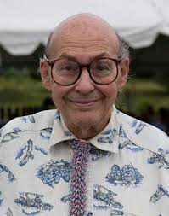
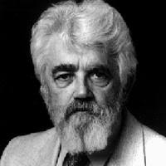
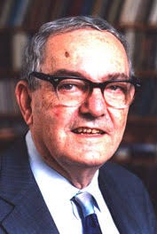
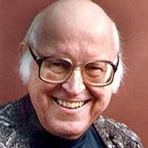
Artificial Intelligence
“Birth day”: Conference at Dartmouth College in 1956, organized by Minsky and McCarthy, McCarthy proposed name of “artificial intelligence”. Simon and Newell attended this conference
Marvin Minsky
John McCarthy
Herbert Simon
Allen Newell

Slide 6
Human ability
Basic ability to develop other abilities
Learn
Reasoning
Language
Human
Action
Listerning/Speaking
Seeing

Slide 7
Human ability
Machine Learning
Basic ability to develop other abilities
Learn
Knowledge Representation and Reasoning
Natural language processing
Reasoning
Language
Human
Robotics
Action
Listerning/Speaking
Speech processing
Vision
Computer vision

Slide 8
Applications of AI
In Medicine
The AI Robot Cleaner at Manchester Airport in England alerts passengers to security and nonsmoking rules
Autonomous car
The Miami Police Bomb squad’s AI robot that is used to locate and deactivate bombs

Slide 9
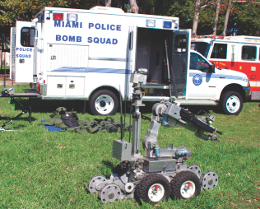
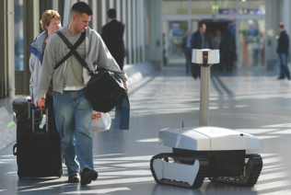
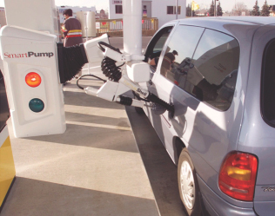
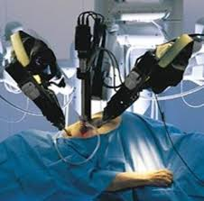
Applications of AI
The ultimate goal of AI is the ability to build a system that can mimic human intelligence
Notes:
Photo one represents an AI Robot at Manchester Airport in England
The Hefner AI Robot Cleaner alerts passengers to security and nonsmoking rules while it scrubs up to 65,600 square feet of floor per day
Photo two displays a SmartPump that keeps drivers in their cars on cold, wet days
The SmartPump can service any automobile built after 1987 that has been fitted with a special gas cap and a windshield-mounted transponder that tells the robot where to insert the pump
Photo three displays the Miami Police Bomb squad’s AI robot that is used to locate and deactivate bombs
Highlight the security and safety that can be gained through the use of AI robots for your class

Slide 10

Applications of AI
Actions

Slide 11

Applications of AI
Actions

Slide 12

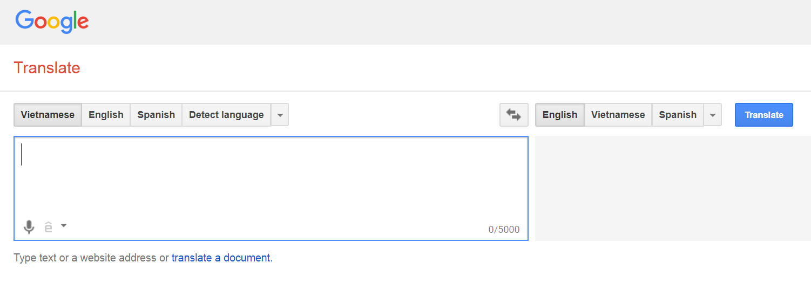
Applications of AI
Languages

Slide 13
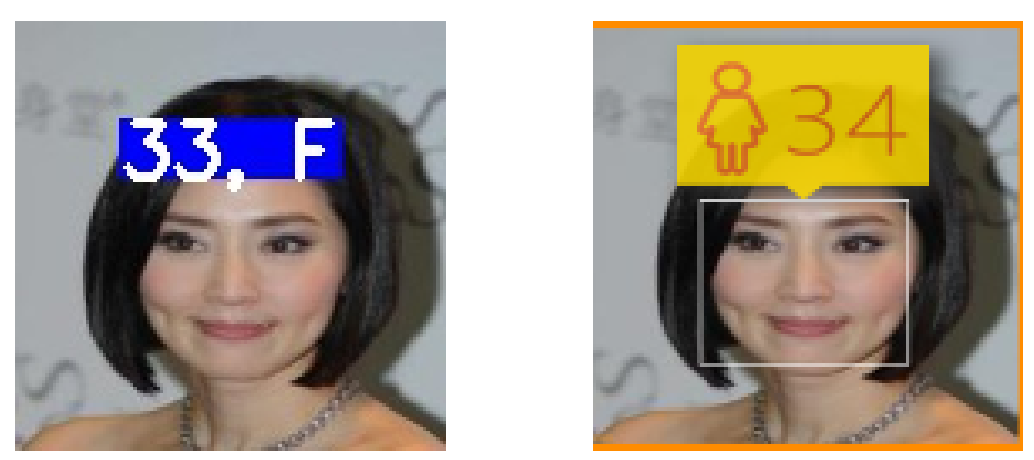
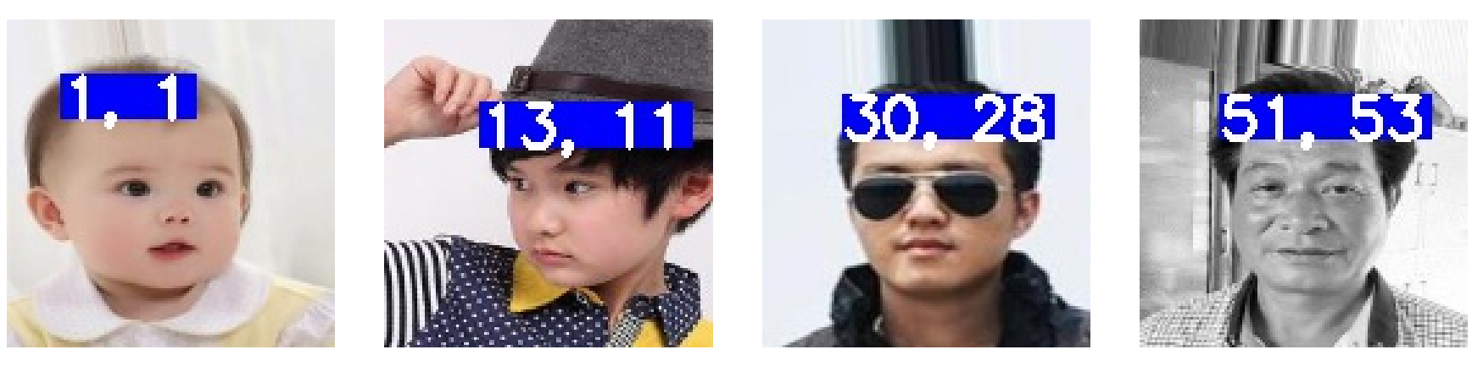
Applications of AI
Vision

Slide 14

Applications of AI
Vision

Slide 15
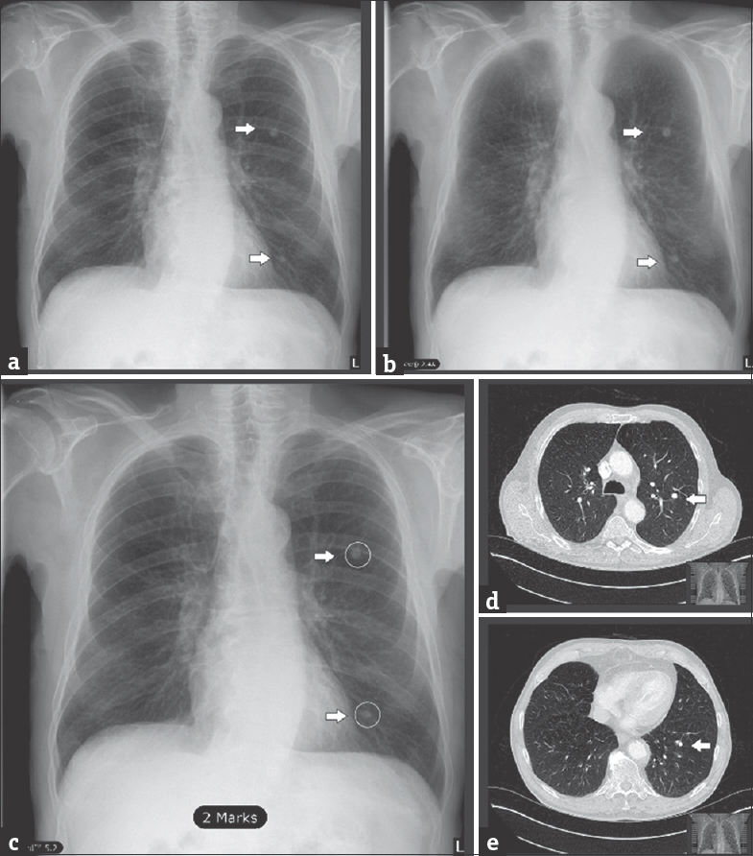
Applications of AI

Slide 16
Related topics in AI
Expert systems
Fuzzy logic
Neural network
Support vector machine
Genetic algorithm
Intelligent Agents
Deep learning

Slide 17
Expert systems
Computerized advisory programs that imitate the reasoning processes of experts in solving difficult problems
Human expertise is transferred to the expert system, and users can access the expert system for specific advice
Most expert systems contain information from many human experts and can therefore perform a better analysis than any single human
Notes:
Expert systems
Human expertise is transferred to the expert system, and users can access the expert system for specific advice
Most expert systems contain information from many human experts and can therefore perform a better analysis than any single human
Ask your students how expert systems could be used in the medical field
Neural networks
Neural networks are most useful for decisions that involve patterns or image recognition
Typically used in the finance industry to discover credit card fraud by analyzing individual spending behavior

Slide 18
Expert systems
Most expert systems deal with problems of classification
Used for discrete, highly structured decision-making
Have relatively few alternative outcomes
Possible outcomes are known in advance

Slide 19
Expert systems
Countrywide Funding Corp uses an expert system to improve decisions about granting loans using a PC based system that makes preliminary credit worthiness decisions on loan requests
The systems has about 400 rules. It tested the system against an actual underwriter and refined the system until it agreed with the underwriter 95% of the time
All rejected loans are reviewed by an underwriter
An underwriter can now evaluate at least 16 loans per day as compared to 6 or 7 previously
The system is being used on their Web site to help customers who are inquiring is they qualify for a loan

Slide 20
Expert systems
MYCIN – an expert system developed by Stanford University in the 1970s to assist physicians in the diagnosis of infectious diseases. The system would ask a series of questions designed to emulate the thinking of an expert in the field of infectious disease and from the responses to these questions give a list of possible diagnoses, with probability, as well as recommend treatment
outperformed members of the Stanford medical school but not used because of ethical and legal issues related to the use of computers in medicine

Slide 21
Fuzzy logic
Fuzzy logic – a mathematical method of handling imprecise or subjective information
Rule-based technology that represents imprecision used in linguistic categories (e.g., “cold,” “cool”) that represent range of values
A washing machine continues to wash until the clothes are clean. How do you define clean?
Analyze financial information that has a subjective value (good will).
In Japan, the subway system uses fuzzy logic controls to accelerate so smoothly that standing passengers need not hold on
A system has been developed to detect possible fraud in medical claims submitted by healthcare providers

Slide 22
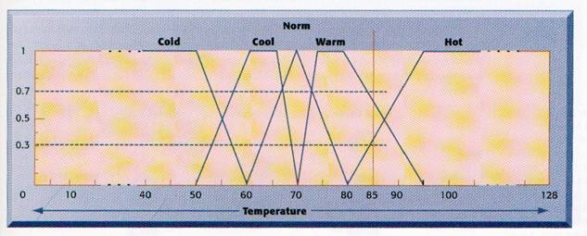
Fuzzy logic
Fuzzy logic can be used in a computer program to automatically control room temperature
Cool is between 50-70 degress, although 60-67 is most clearly cool. Cool is overlapped by cold and norm.
Thus a rule might be “if the temperature is cool or cold and the humidity is low while the outdoor wind is high and the outdoor temperature is low, raise the heat and humidity in the room”

Slide 23
Neural Network
Neural Network – attempts to emulate the way the human brain works
Most useful for decisions that involve patterns or image recognition
“Learn” patterns by searching for relationships, building models, and correcting over and over again
Humans “train” network by feeding it data inputs for which outputs are known, to help neural network learn solution by example
Used for solving complex, poorly understood problems for which large amounts of data have been collected
Typically used in the finance industry to discover credit card fraud by analyzing individual spending behavior
US Bancorp has cut credit card fraud by 70% using this technology

Slide 24
Neural Networks
Neural nets consist of an input layer, output layer and one or mode hidden internal layers
Input and output layers are connected to the middle layers by “weights” of various strengths
Weights change as the net learns what is good and bad (e.g. credit card transaction) and stabilize after having been fed enough examples
Differs from expert system in that expert system follows rigid rules that don’t change. Neural net rules change based on experience.

Slide 25
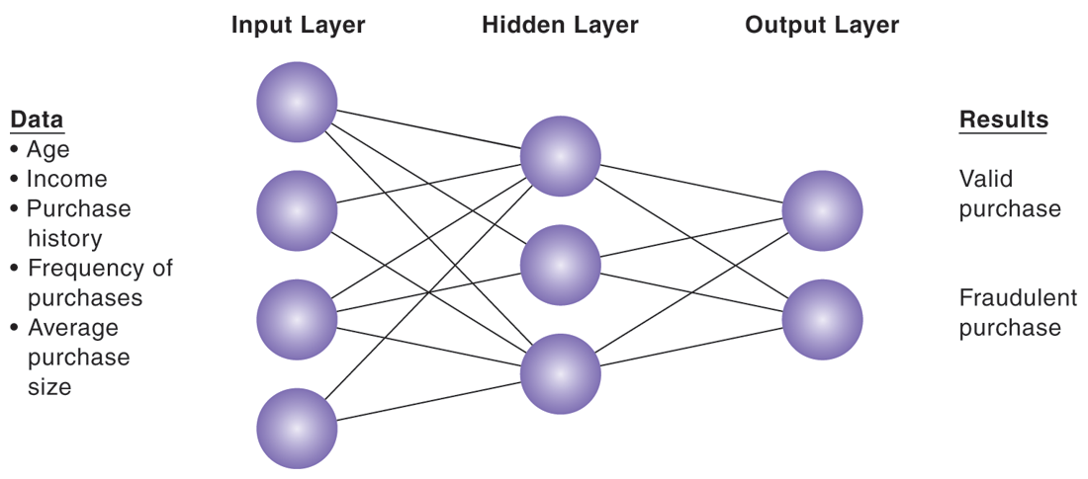
The Layers of a Neural Network
A neural network uses rules it “learns” from patterns in data to construct a hidden layer of logic. The hidden layer then processes inputs, classifying them based on the experience of the model. In this example, the neural network has been trained to distinguish between valid and fraudulent credit card purchases

Slide 26
Neural Networks …
Learn and adjust to new circumstances on their own
Take part in massive parallel processing
Function without complete information
Cope with huge volumes of information
May not perform well if their training covers too little or too much data
Doesn’t guarantee a best solution
Best used as an aid to human decision makers instead of replacing them

Slide 27
Genetic Algorithms
Genetic algorithm – an artificial intelligent system that mimics the evolutionary, survival-of-the-fittest process to generate increasingly better solutions to a problem
Useful for finding optimal solution for specific problem by examining very large number of possible solutions for that problem
Conceptually based on process of evolution
Search among solution variables by changing and reorganizing component parts using processes such as inheritance, mutation, and selection
Used in optimization problems (minimization of costs, efficient scheduling, optimal jet engine design) in which hundreds or thousands of variables exist
Able to evaluate many solution alternatives quickly

Slide 28
Evolutionary Principles of Genetic Algorithms
Selection – or survival of the fittest or giving preference to better outcomes
Crossover – combining portion of good outcomes to create even better outcomes
Mutation – randomly trying combinations and evaluating the success of each

Slide 29
The basic genetic algorithm
Start with a large “population” of randomly generated “attempted solutions” to a problem
Repeatedly do the following:
Evaluate each of the attempted solutions
Keep a subset of these solutions (the “best” ones)
Randomly mutate some solutions
Use these solutions to generate a new population
Quit when you have a satisfactory solution (or you run out of time)

Slide 30
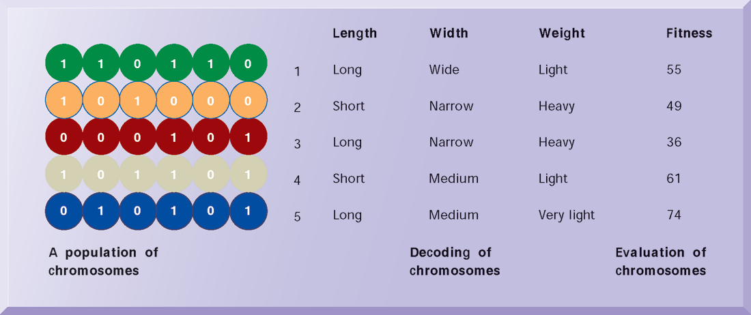
Genetic Algorithms
This example illustrates an initial population of “chromosomes,” each representing a different solution. The genetic algorithm uses an iterative process to refine the initial solutions so that the better ones, those with the higher fitness, are more likely to emerge as the best solution.

Slide 31
A really simple example
Suppose your “organisms” are 32-bit computer words, and you want a string in which all the bits are ones
Here’s how you can do it:
Create 100 randomly generated computer words
Repeatedly do the following:
Count the 1 bits in each word
Exit if any of the words have all 32 bits set to 1
Keep the ten words that have the most 1s (discard the rest)
From each word, generate 9 new words as follows:
Choose one of the other words
Take the first half of this word and combine it with the second half of the other word

Slide 32
The example continued
Half from one, half from the other: 0110 1001 0100 1110 1010 1101 1011 0101 1101 0100 0101 1010 1011 0100 1010 0101 0110 1001 0100 1110 1011 0100 1010 0101
Or we might choose “genes” (bits) randomly: 0110 1001 0100 1110 1010 1101 1011 0101 1101 0100 0101 1010 1011 0100 1010 0101 0100 0101 0100 1010 1010 1100 1011 0101
Or we might consider a “gene” to be a larger unit: 0110 1001 0100 1110 1010 1101 1011 0101 1101 0100 0101 1010 1011 0100 1010 0101 1101 1001 0101 1010 1010 1101 1010 0101

Slide 33
A really simple example
However, with no mutation, it may not succeed at all
By pure bad luck, maybe none of the first (randomly generated) words have (say) bit 17 set to 1
Then there is no way a 1 could ever occur in this position
Another problem is lack of genetic diversity
Maybe some of the first generation did have bit 17 set to 1, but none of them were selected for the second generation

Slide 34
Genetic Algorithms
Take thousands or even millions of possible solutions, combine and recombine them until the optimal solution is found
Example: Create a portfolio of 20 stocks with growth rate of 7.5%
Pick a large group of stocks, combine them into groups of 20 at a time and see how each group performed based on historic information
30 stocks → 30 million combinations, 40 stocks → 137 billion possibilities of 20
US West uses this technique to determine the optimal configuration of fiber-optic cable in a network that may include as many as 100,000 connection points
Used take 2 months for an experienced designer, now 2 days and saves $1-$10 million each time it’s used

Slide 35
Genetic Algorithm Applications
GE used them help optimize the design of a jet turbine aircraft engine
SCM software from i2 Technologies optimizes production-scheduling models incorporating hundreds of thousands of details about customer orders, material and resource availability, manufacturing and distribution capability and delivery dates

Slide 36
Intelligent Agents
Intelligent agent – special-purposed knowledge-based information system that accomplishes specific tasks on behalf of its users
Used for environmental scanning and competitive intelligence
An intelligent agent can learn the types of competitor information users want to track, continuously scan the Web for it, and alert users when a significant event occurs
software that assists you, or acts on your behalf, in performing repetitive computer-related tasks (e.g., paper clip in Word)
Buyer agents or shopping bots
User or personal agents
Monitoring-and surveillance agents
Data-mining agents

Slide 37
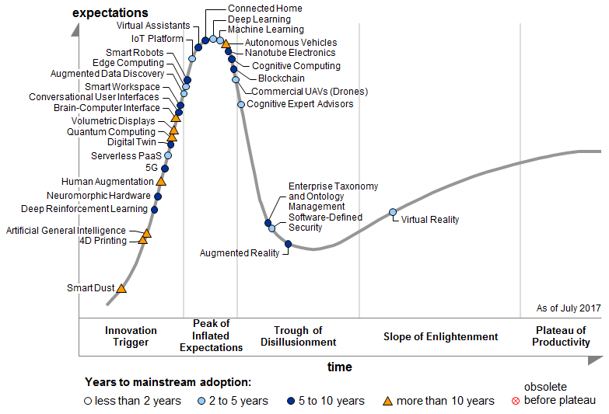
Why the AI is hot?

Slide 38
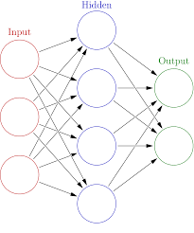
Why the AI is hot?
AI (1956)
Machine Learning (1956)
ANN (1943)
Before 2005

Slide 39
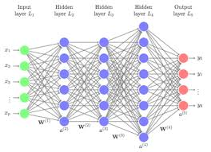
Why the AI is hot?
AI (1956)
Machine learning(1956)
ANN (1943)
Deep learning(2006)

Slide 40
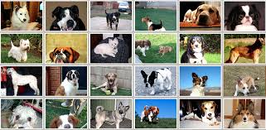
Why the AI is hot?
Image recognition competition (ILSVRC)
Number of classes: 1000
Dogs,
Cats,
Fishes,…
# of training samples
ILSVRC-2010: 1.2 million images
ILSVRC-2017: >14 million images
# of testing samples
ILSVRC-2010: 100.000 million images
ILSVRC-2017: hundreds thousand of images

Slide 41
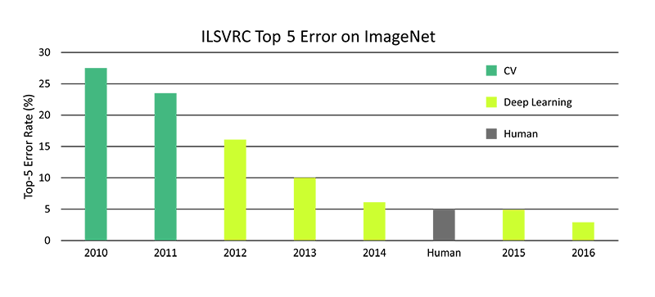
Why the AI is hot?
6.7%
3.6%
3%
Results

Slide 42
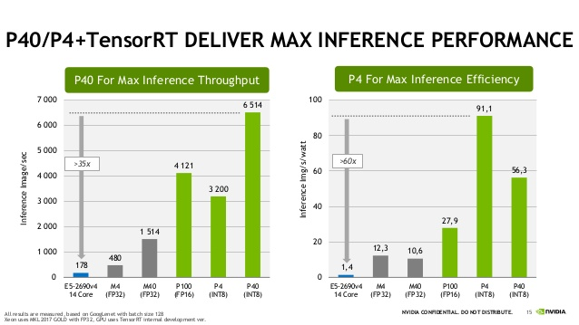
Why the AI is hot?

Slide 43
Some other advantages of AI
More powerful and more useful computers
New and improved interfaces
Solving new problems
Better handling of information
Relieves information overload
Conversion of information into knowledge

Slide 44
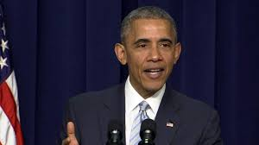
Potential risks
Fake news

Slide 45
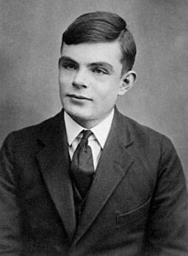
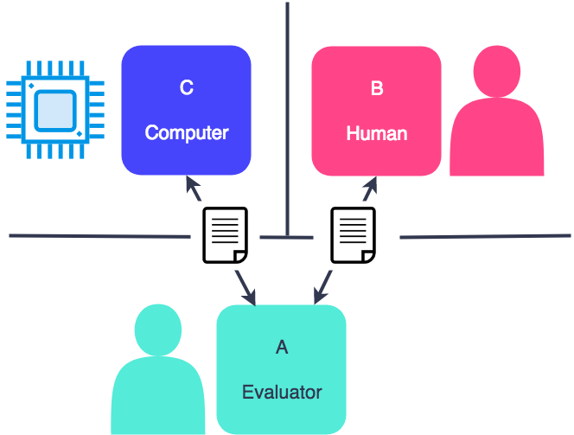
Potential risks
Turing test
C
Computer
B
Person
Alan Turing
A
Tester

